Slide 1
Analysis of Marvis Minis Connectivity Test Results
Juniper Networks
NIDHI S
231058001
Project Start Date: 10/06/2024

Slide 2
Key Contacts
H R Details:
Rachita Dash
drachita@juniper.net
Guide at Industry:
Shirley Wu
Software Engineering Senior Director
shirleywu@juniper.net

Slide 3
Contents
Introduction
Methodology
Work Done
Results
Future Work
References

Slide 4
Introduction
Marvis Minis is a cloud service that orchestrates synthetic tests on network devices.
Automates synthetic tests on APs, switches and gateways for seamless network validation.
It can assist in identifying and fixing problems before they affect the actual users.
It automatically generates the tests to perform after learning about all the switches, APs, WLANs and active VLANs in a site

Slide 5
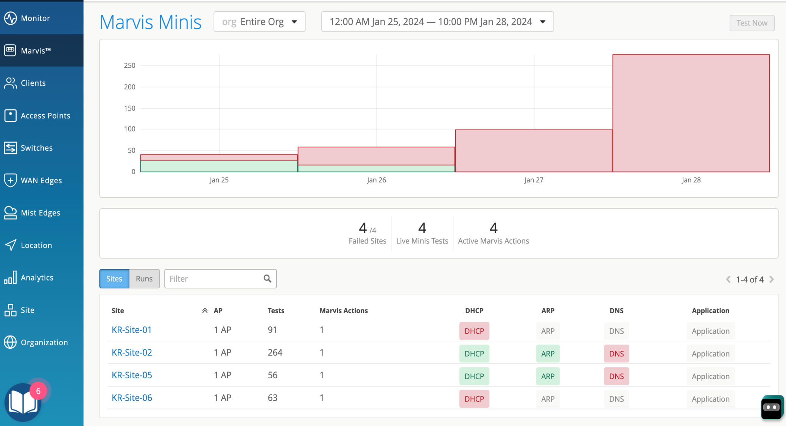
The validation findings are visible on the Marvis Minis dashboard

Slide 6
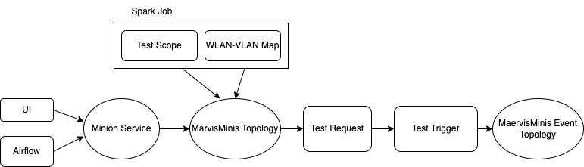
Methodology

Slide 7
Work Done
Enhanced Test Scope Generation Spark Job
Investigated patterns in failures and timeouts
Analyzed retries and test duration trends
Troubleshooting missing Reports even when the tests are triggered
Root Cause Analysis of Failures (DNS, DHCP, ARP, CURL)

Slide 8
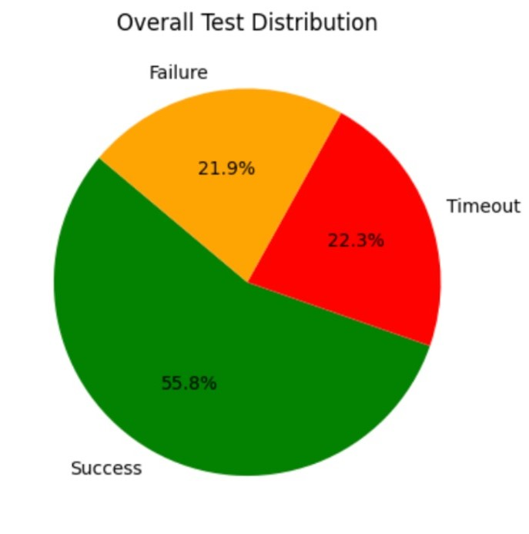
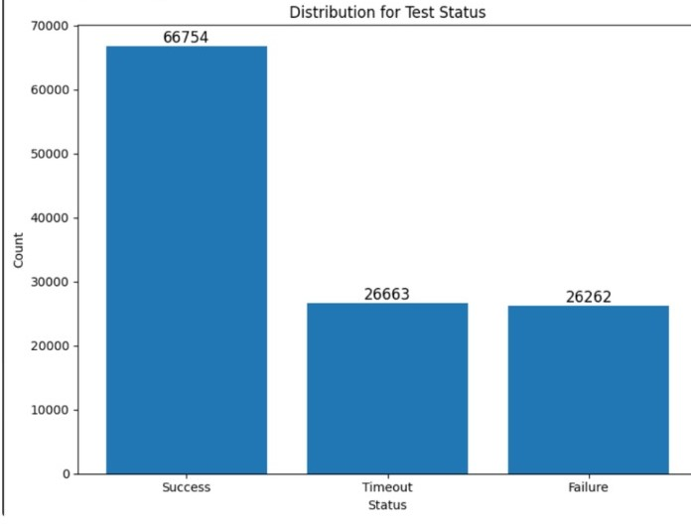
Results
Pie and Bar chart representing the Overall test Distribution

Slide 9
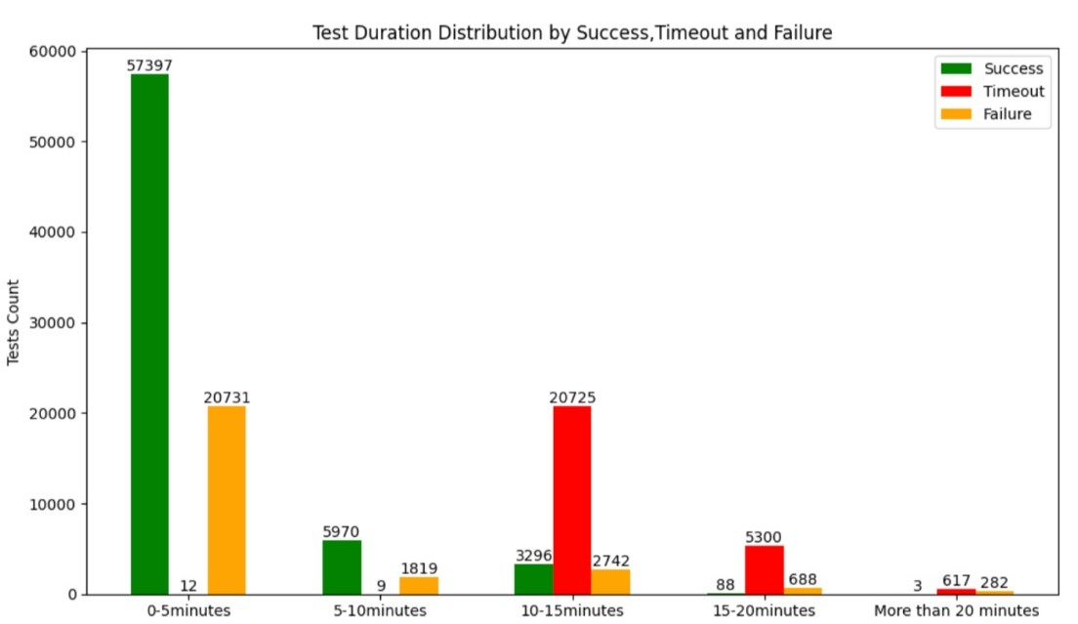
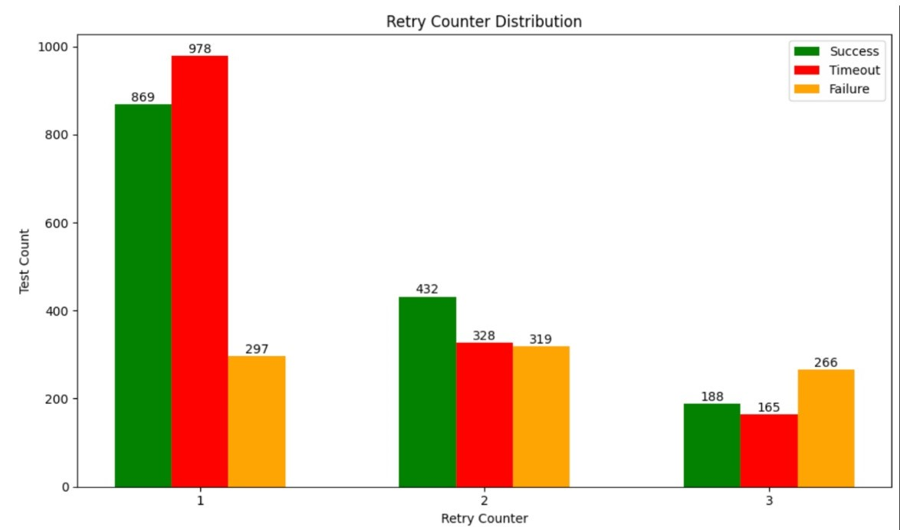
Results
Bar chart representing the test duration and the number of retries

Slide 10
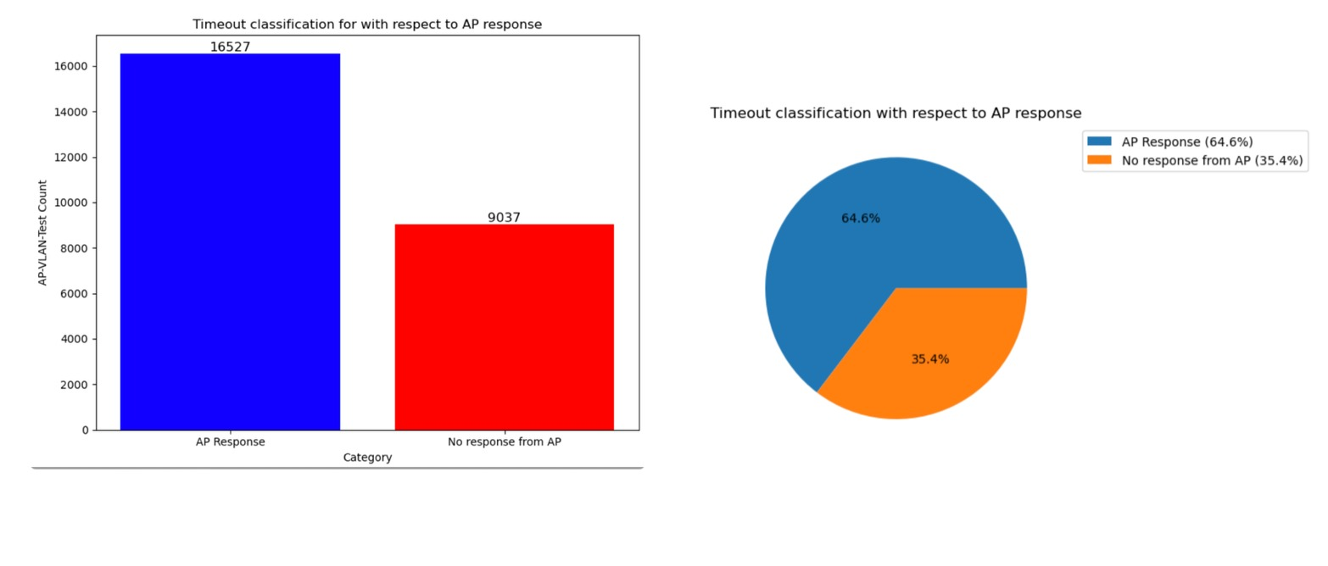
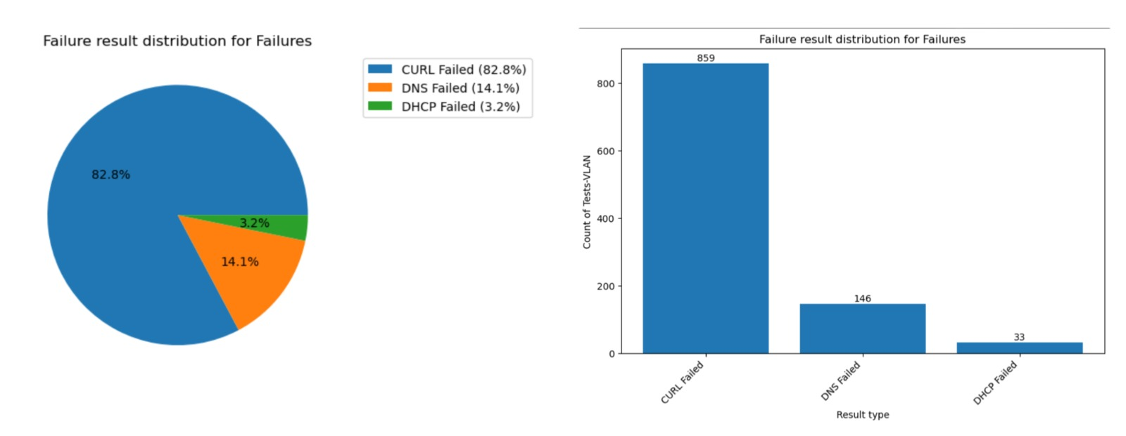
Results
. Bar and Pie chart representing the test count with and without AP response
Pie and Bar chart representing the Failure result distribution

Slide 11
Future Work
Analysing trends in latency values to identify normal behaviour patterns over time.
Identify and flag outliers in latency values for deeper investigation.
Performing the latency analysis on a per URL basis to uncover potential URL specific issues.
Investigating latency patterns across different VLANs and sites to detect any anomalies tied to VLAN-Site specific configurations.
Using statistical methods like mean, variance and standard deviation to identify outliers.

Slide 12
References
https://www.juniper.net/documentation/us/en/software/mist/mist-aiops/topics/topic-map/marvis-minis-overview.html
https://sparkbyexamples.com/spark/what-is-spark-job/
https://pratikbarjatya.medium.com/demystifying-spark-jobs-stages-and-tasks-a-simplified-guide-f35da5ab4aa6

Slide 13
THANK YOU

